Slide 1
CA1 AIML REGRESSION
Haaris Sulaiman P2112815

Slide 2
TASK PREDICTION

Slide 3
The prediction task
The task is to predict the price of different computers based on their configuration. I will be building regression models so that i can predict the price based on the features that I will be engineering.

Slide 4
DATA EXPLORATION

Slide 5
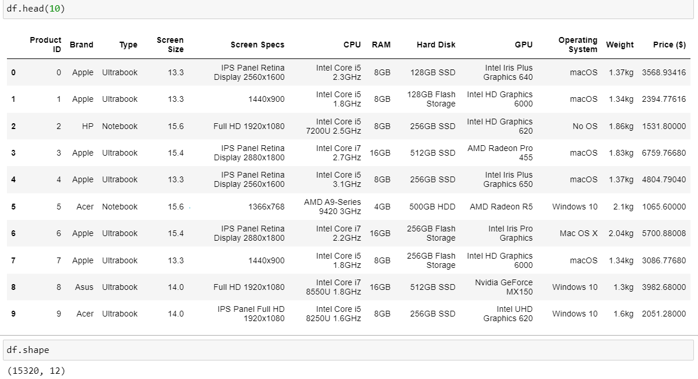

Slide 6
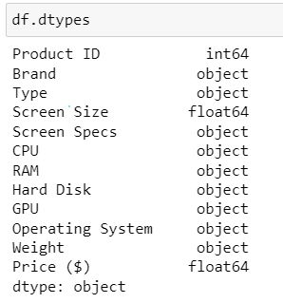
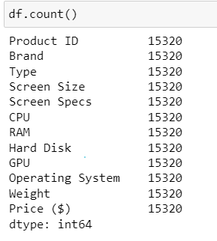
There are many object data types that need to be converted to int or float. All columns have 15320 rows of data denoting no missing values.

Slide 7
DATA CLEANING

Slide 8
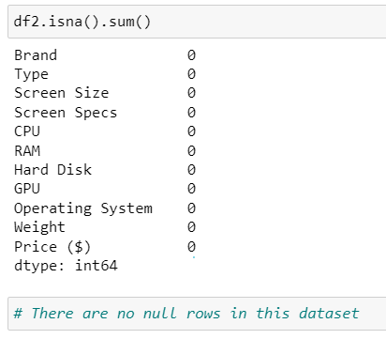
Checking for null
There are no null rows for this dataset.

Slide 9
FEATURE ENGINEERING

Slide 10
Overview
Splitting columns with number and words to retain the number
Splitting columns to obtain the brand of cpu/gpu
Dropping column I do not require
Assigning words to number
Doing hot encoding using lambda functions
Changing strings to integers or float

Slide 11
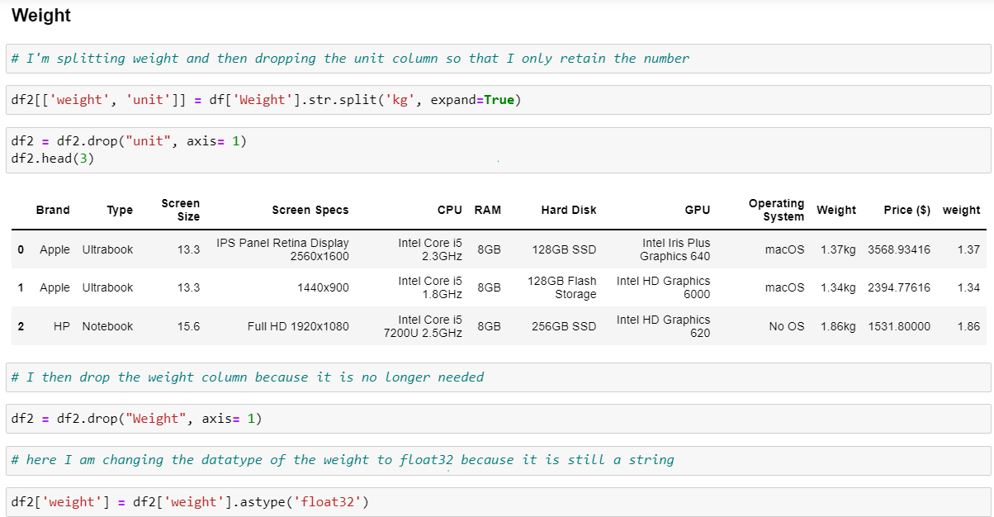

Slide 12
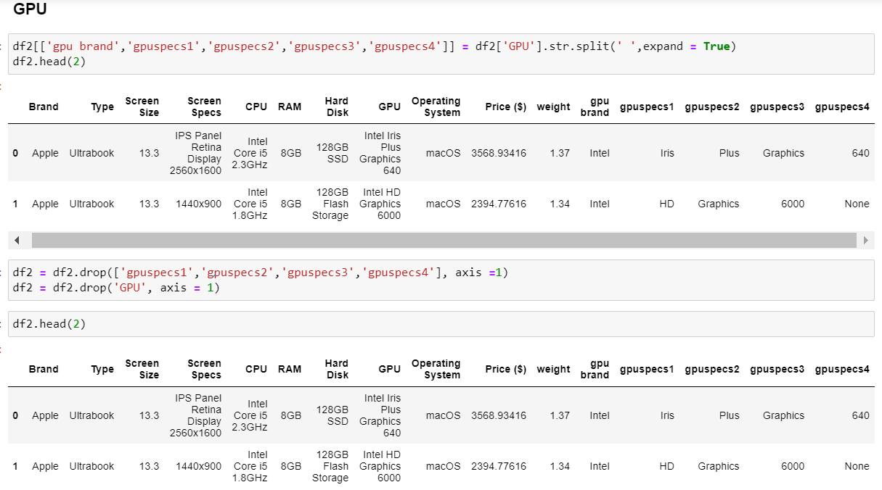

Slide 13
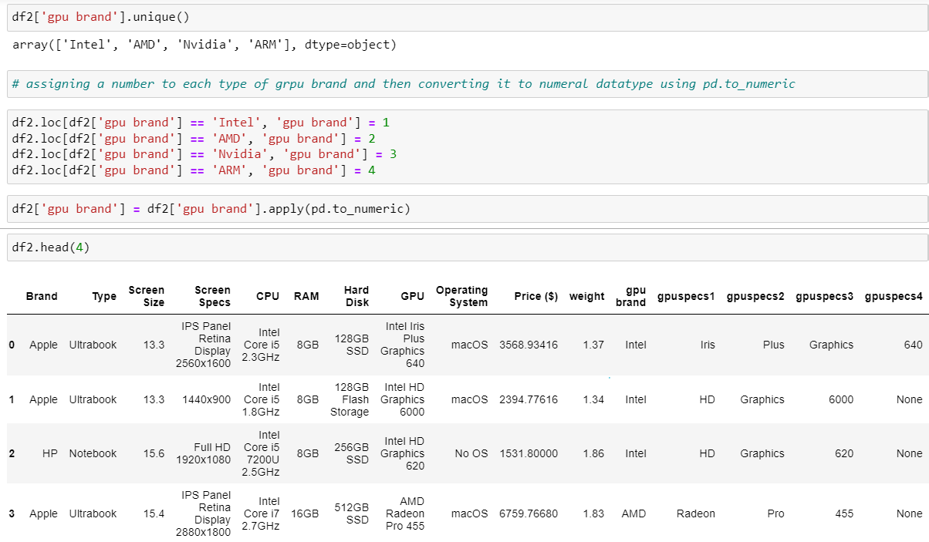

Slide 14
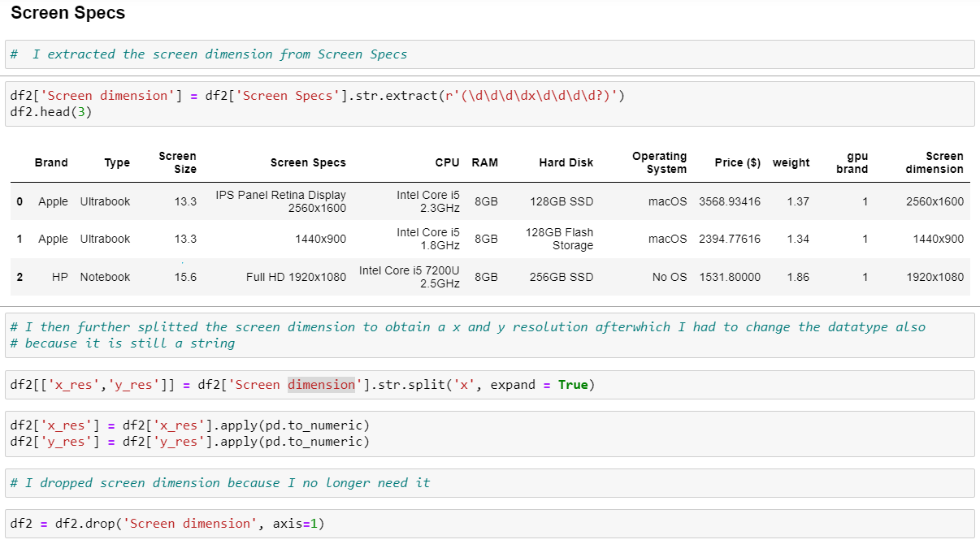

Slide 15
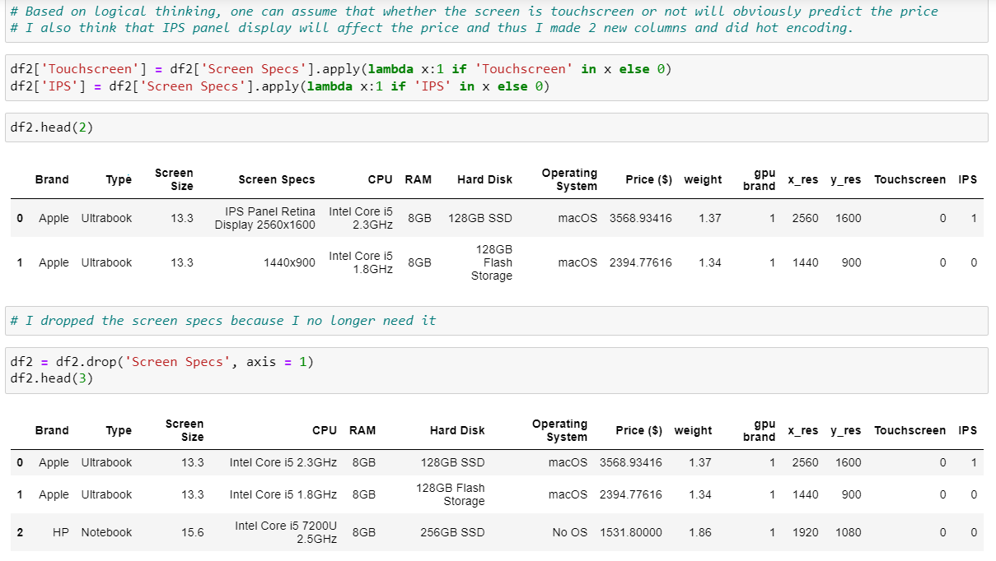

Slide 16
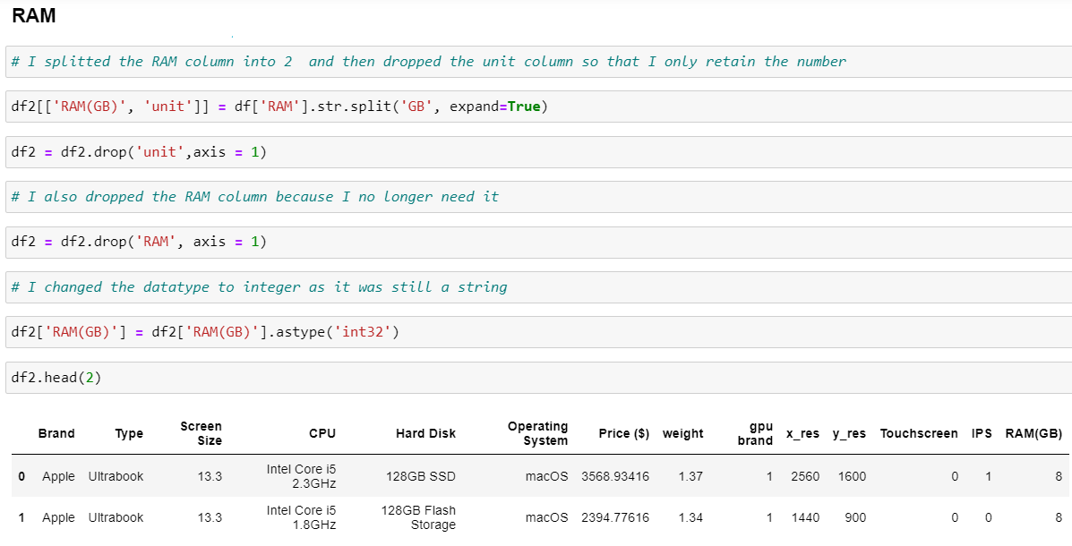

Slide 17
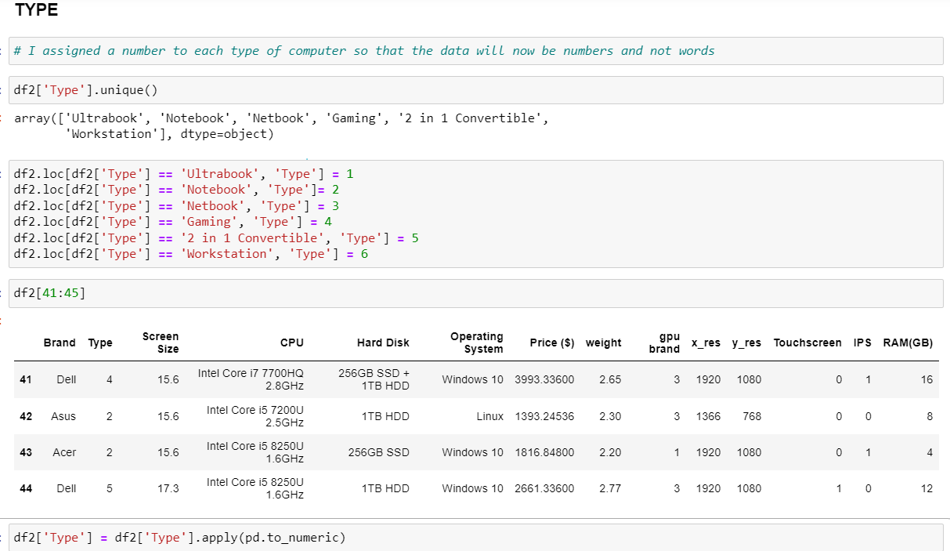

Slide 18
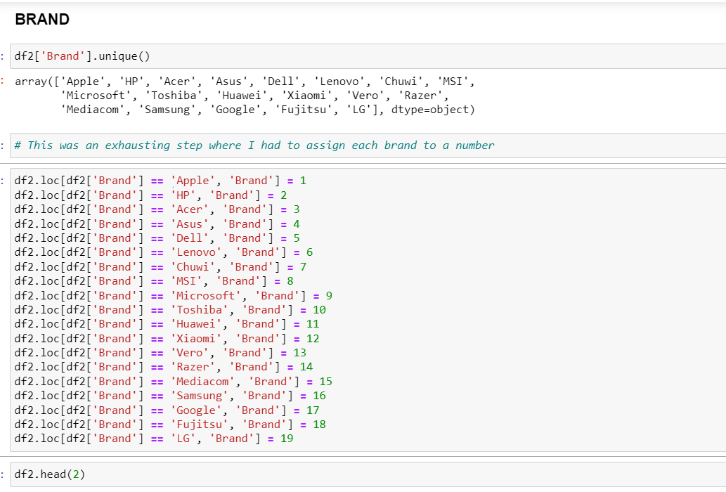

Slide 19
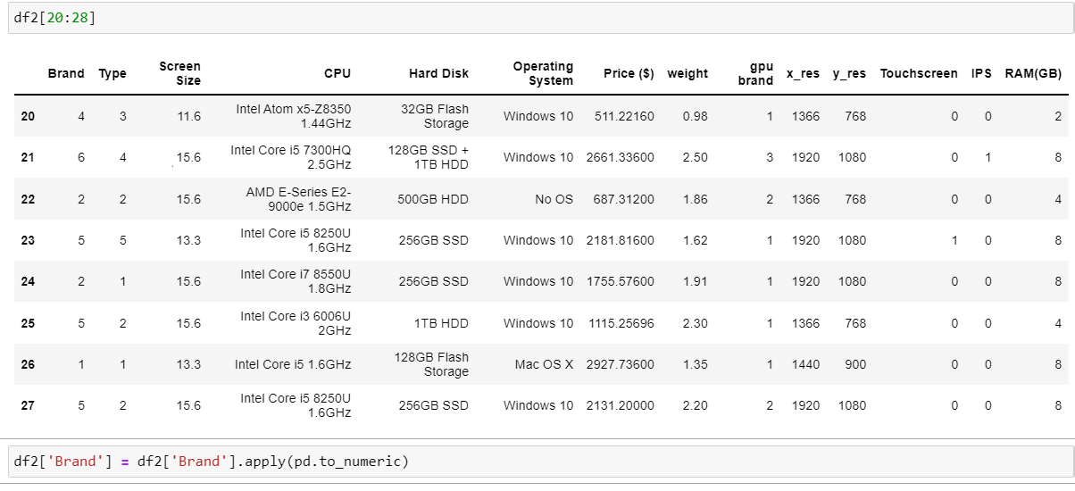

Slide 20
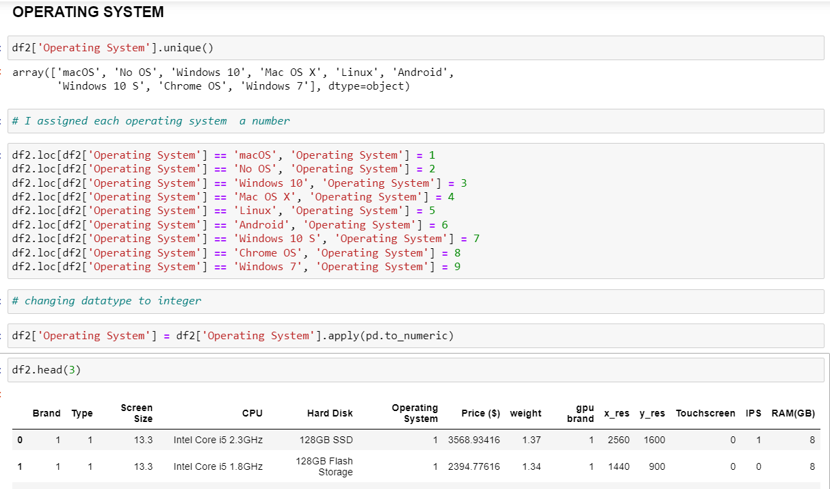

Slide 21
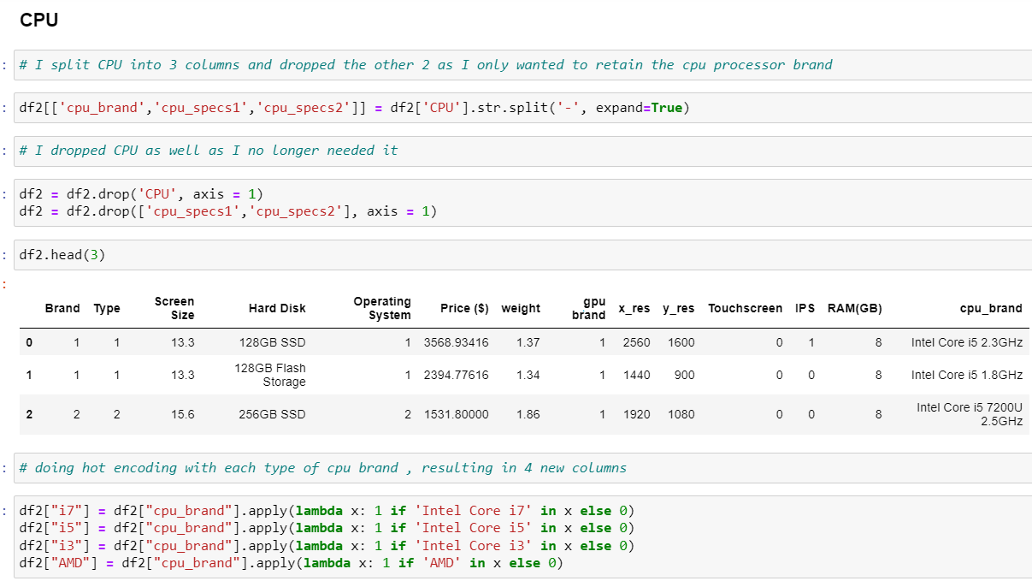

Slide 22
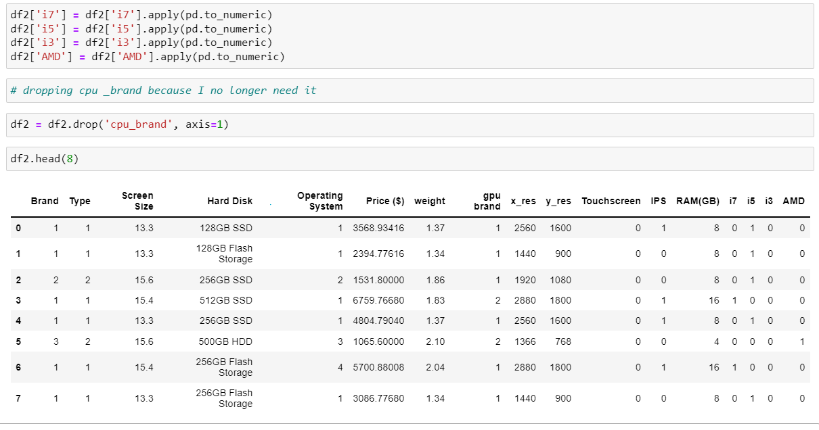

Slide 23
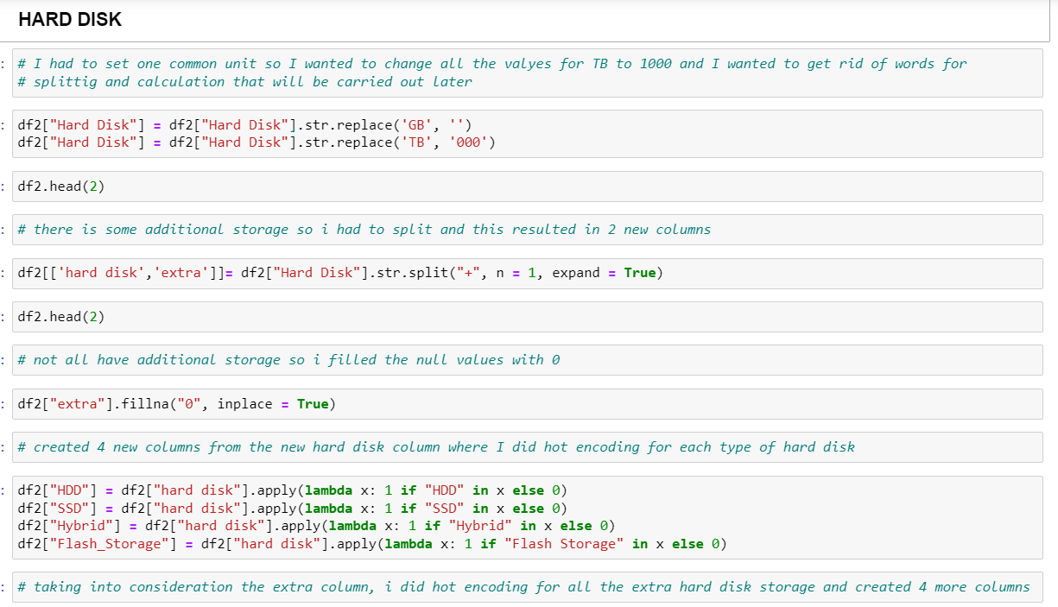

Slide 24
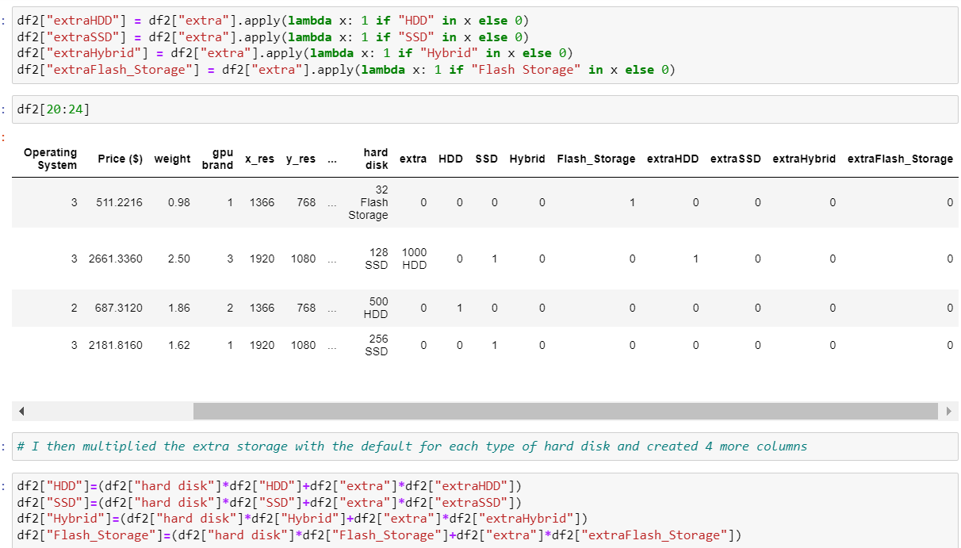

Slide 25
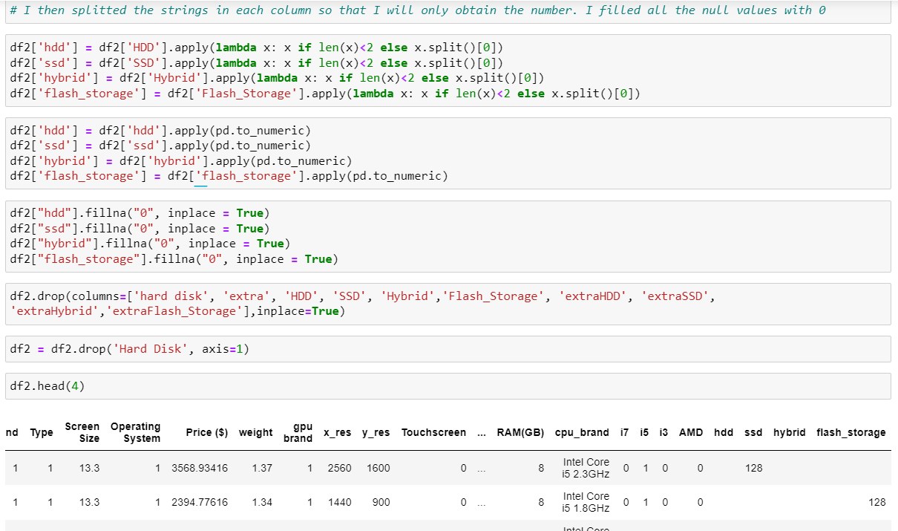

Slide 26
EXPLORY DATA ANALYSIS

Slide 27
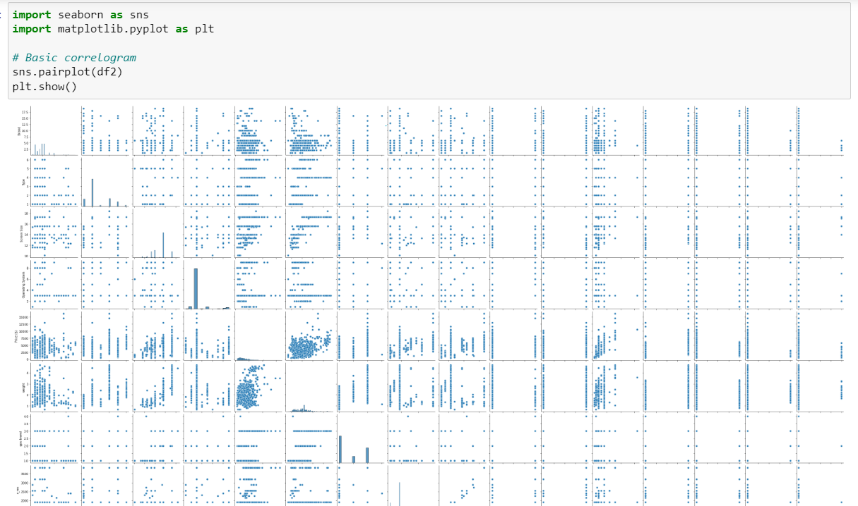

Slide 28
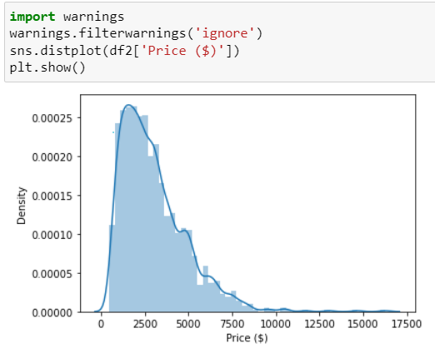
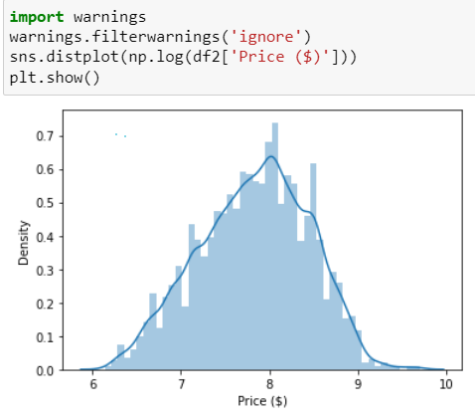
Price

Slide 29
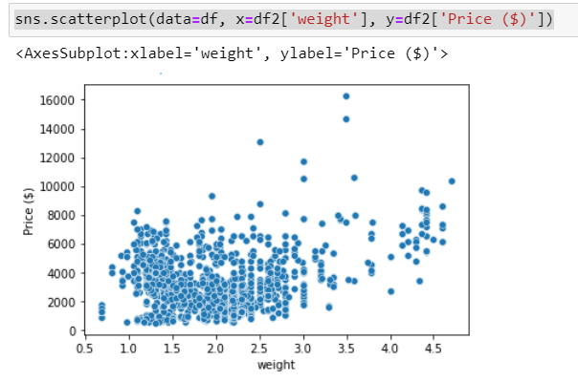
Weight
There is a positive relationship between weight and price. As weight increase, price increase.

Slide 30
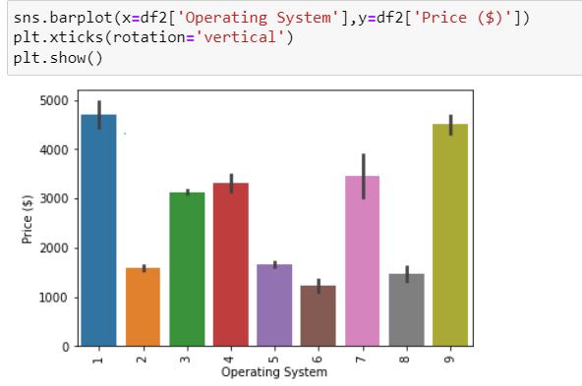
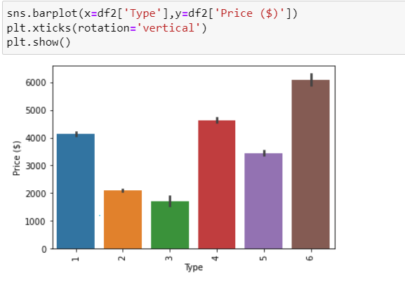
OS and Type

Slide 31
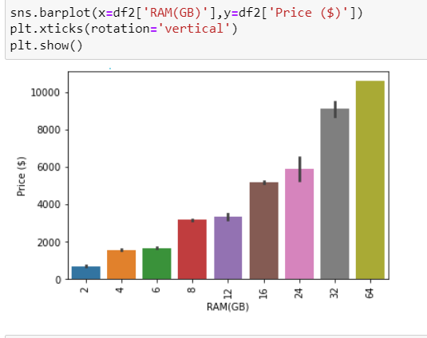
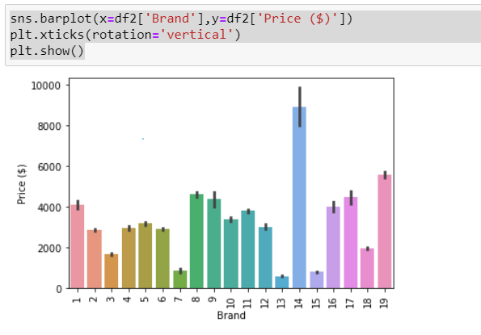
RAM and Brand

Slide 32
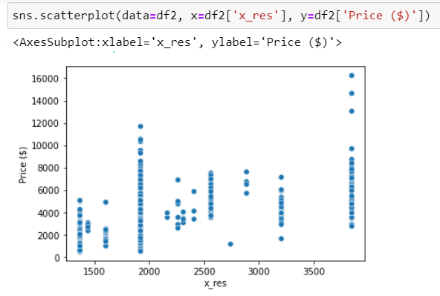
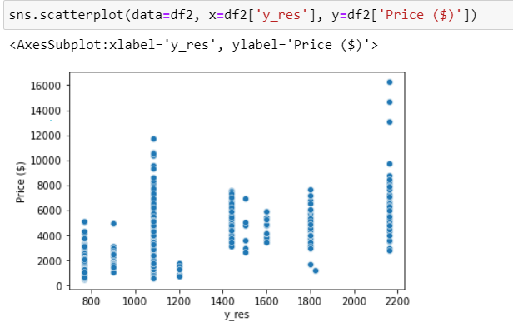
X and Y resolution

Slide 33
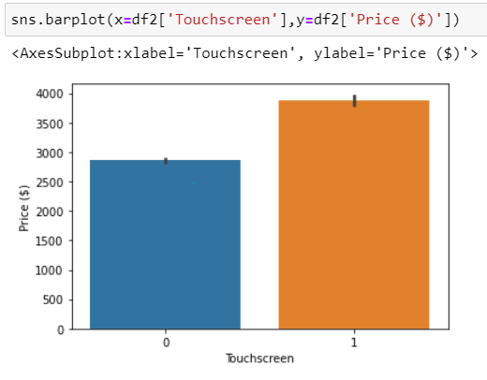
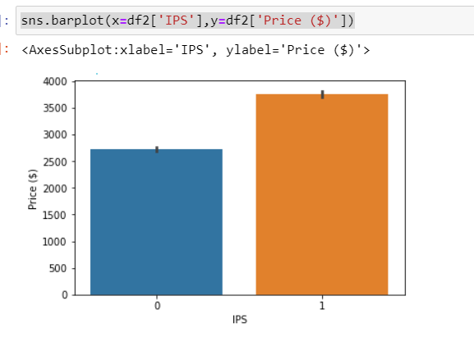
Touchscreen and IPS

Slide 34
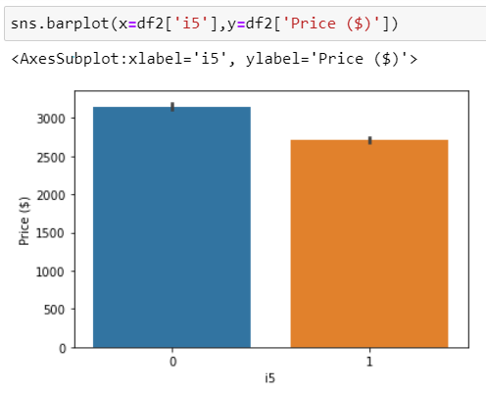
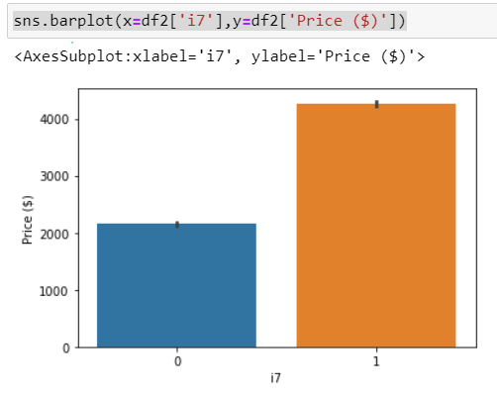
i5 and i7

Slide 35
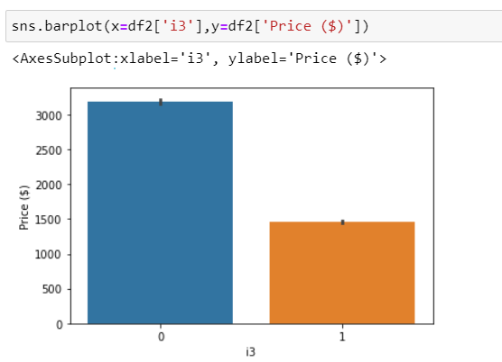
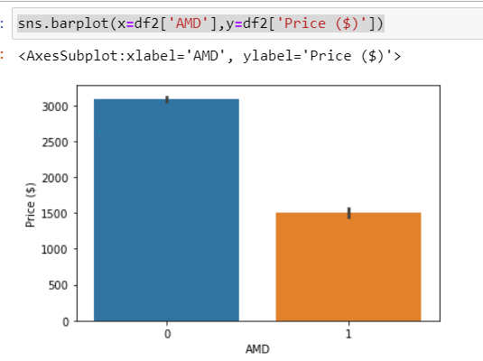
AMD and i3

Slide 36
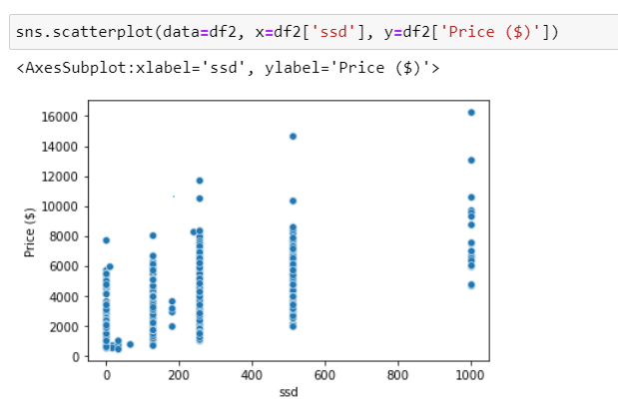
SSD
There is a positive relationship between ssd and price. From the graph, higher ssd has higher prices

Slide 37
FITTING THE MODEL

Slide 38
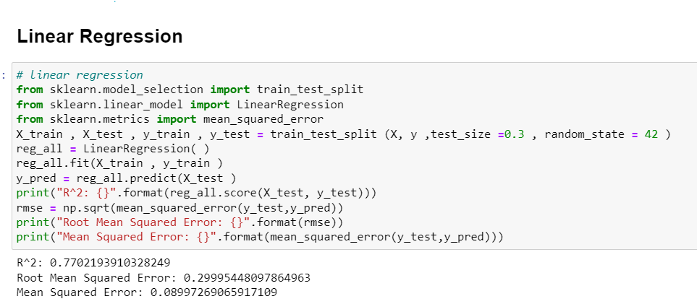
Linear Regression

Slide 39
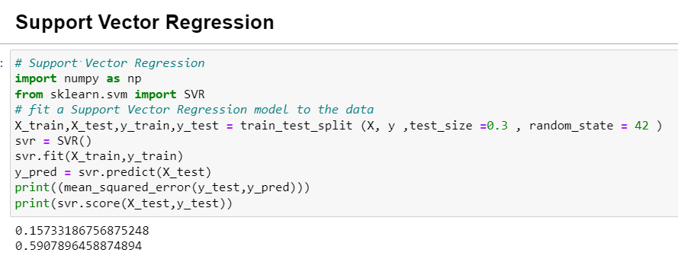
Support Vector Regression

Slide 40
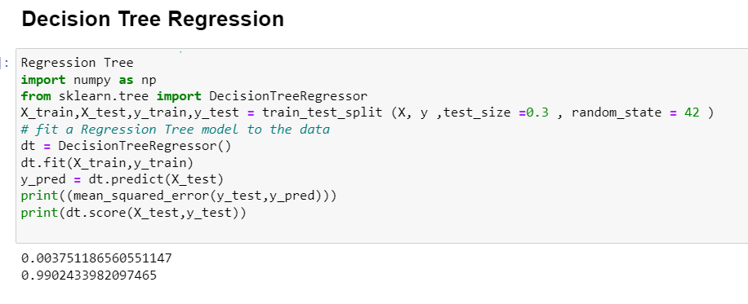
Decision Tree Regression

Slide 41
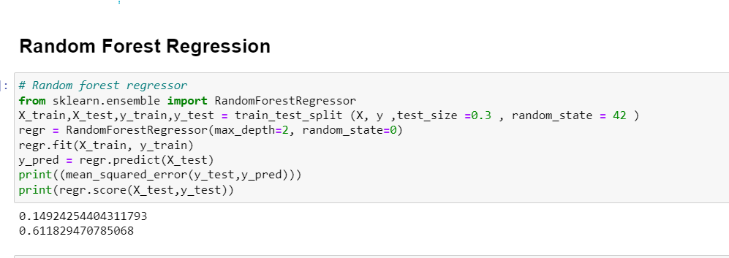
Random Forest Regression

Slide 42
MODEL SELECTION

Slide 43
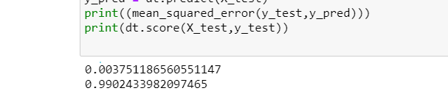
Selecting the best model
The decision tree regressor has the highest r2 score of 0.99 and lowest mse of 0.000375 which is very close to 0. Hence, I choose DecisionTreeRegressor()

Slide 44
CROSS VALIDATION & HYPERPARAMETER TUNING

Slide 45
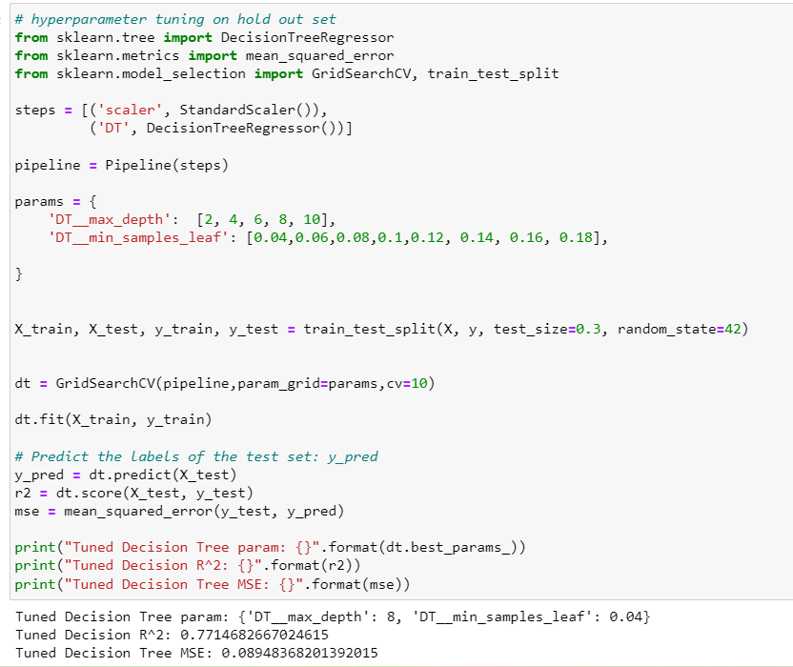

Slide 46
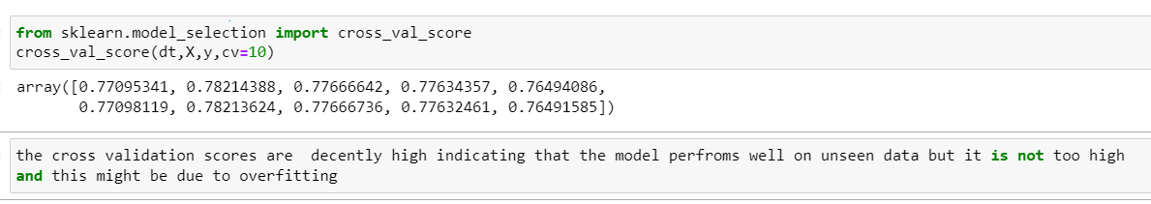
Cross-validation score
There is a chance of overfitting since the range of cross validation score is not that high however is it still decently high to show that the model can perform quite well on unseen data

Slide 47
MODEL IMPROVEMENT

Slide 48
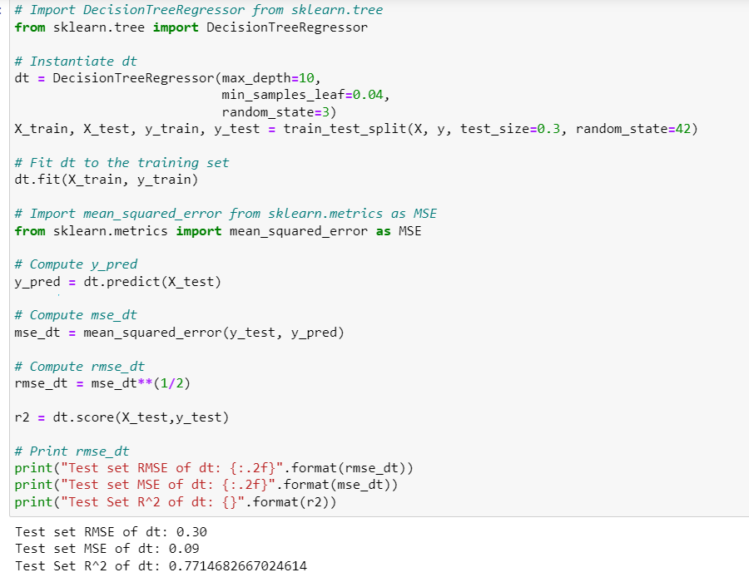

Slide 49
MODEL EVALUATION & CONCLUSION

Slide 50
Evaluating the DecisionTreeRegressor
Before hyperparameter tuning: After tuning:
R2 score: 0.990 R2 score: 0.772
Mse : 0.004 Mse: 0.09
If comapred to the stupid, baseline, my model is preforming well. The r2 score after doing hyperparameter tuning is lower than before tuning as it is no longer overfitted. The r2 score is 0.99 likely due of overfitting. However, the mse score is still good as both 0.004 and 0.09 is close to 0 Hence, DecisionTreeRegressor is the best model for this prediction task.

